Slide 1



Vishwakarma Application ID: VK26-AU-FD-0006
SMART-ASHA (AROGYA AI)
Autonomous Edge-AI Multimodal Physiological Triage Workstation for Rural Frontline Healthcare
Track: Frontier Diagnostics (Next Vital Signs) | Sub-Theme: Non-Invasive Diagnostics
Team: Gauri Gupta (Lead) | Anmol Nandwani | Vansh Sharma
Vivekananda Institute of Professional Studies – Technical Campus (VIPS-TC), Delhi

Slide 2


Problem Context: The Rural Physiological Screening Bottleneck
Frontline Healthcare Diagnostic Crisis
Project Overview: Smart-ASHA (Arogya AI) | Team ID: VK26-AU-FD-0006
Core Innovation: Handheld edge-AI workstation executing zero-consumable multi-vital screening (Thermal, ECG, SpO2, Optical Spectral, Respiratory Gas) with deterministic 0-100 triage in <60 seconds without cloud dependency.
Problem Statement: Over 10 Lakh ASHAs serve 90+ Crore rural citizens across 6.5 Lakh Indian villages. Rural sub-centres suffer severe diagnostic shortages (1 doctor per 1,511 citizens; 72-hour tertiary testing delays; 25-35 min/patient manual logging). Chronic CVDs, respiratory distress, and sepsis remain undiagnosed until emergency hospitalization.

Slide 3


User Journey: Before vs. After State Transformation
Current "Before State" — Fragmented & Slow
Future "After State" — Smart-ASHA Edge Triage
Current Pain Point: ASHA carries 4-5 disconnected tools (BP cuff, pulse oximeter, paper ledger). Manual entry takes 25-35 minutes per patient with 18-24% transcription error rate. Critical cardiac arrhythmias and subclinical fever are routinely missed.
Future Solution: All-in-one handheld workstation captures thermal thermography, Lead-I ECG, SpO2, multi-spectral reflectance, and respiratory gas simultaneously. Edge Impulse INT8 TinyML outputs a real-time 0-100 triage score with instant Green/Yellow/Red LED alerts.
Quantified Efficiency: <60 seconds complete triage (<45s capture + 142ms ML inference) | Zero test consumables | 68% drop in unnecessary referrals | 92.4% validated diagnostic accuracy.
Quantified Inefficiency: 25-35 min/patient screening | ₹1,200 avg patient transport cost for tertiary testing | 72-hr referral turnaround | 68% unnecessary tertiary hospital congestion.

Slide 4






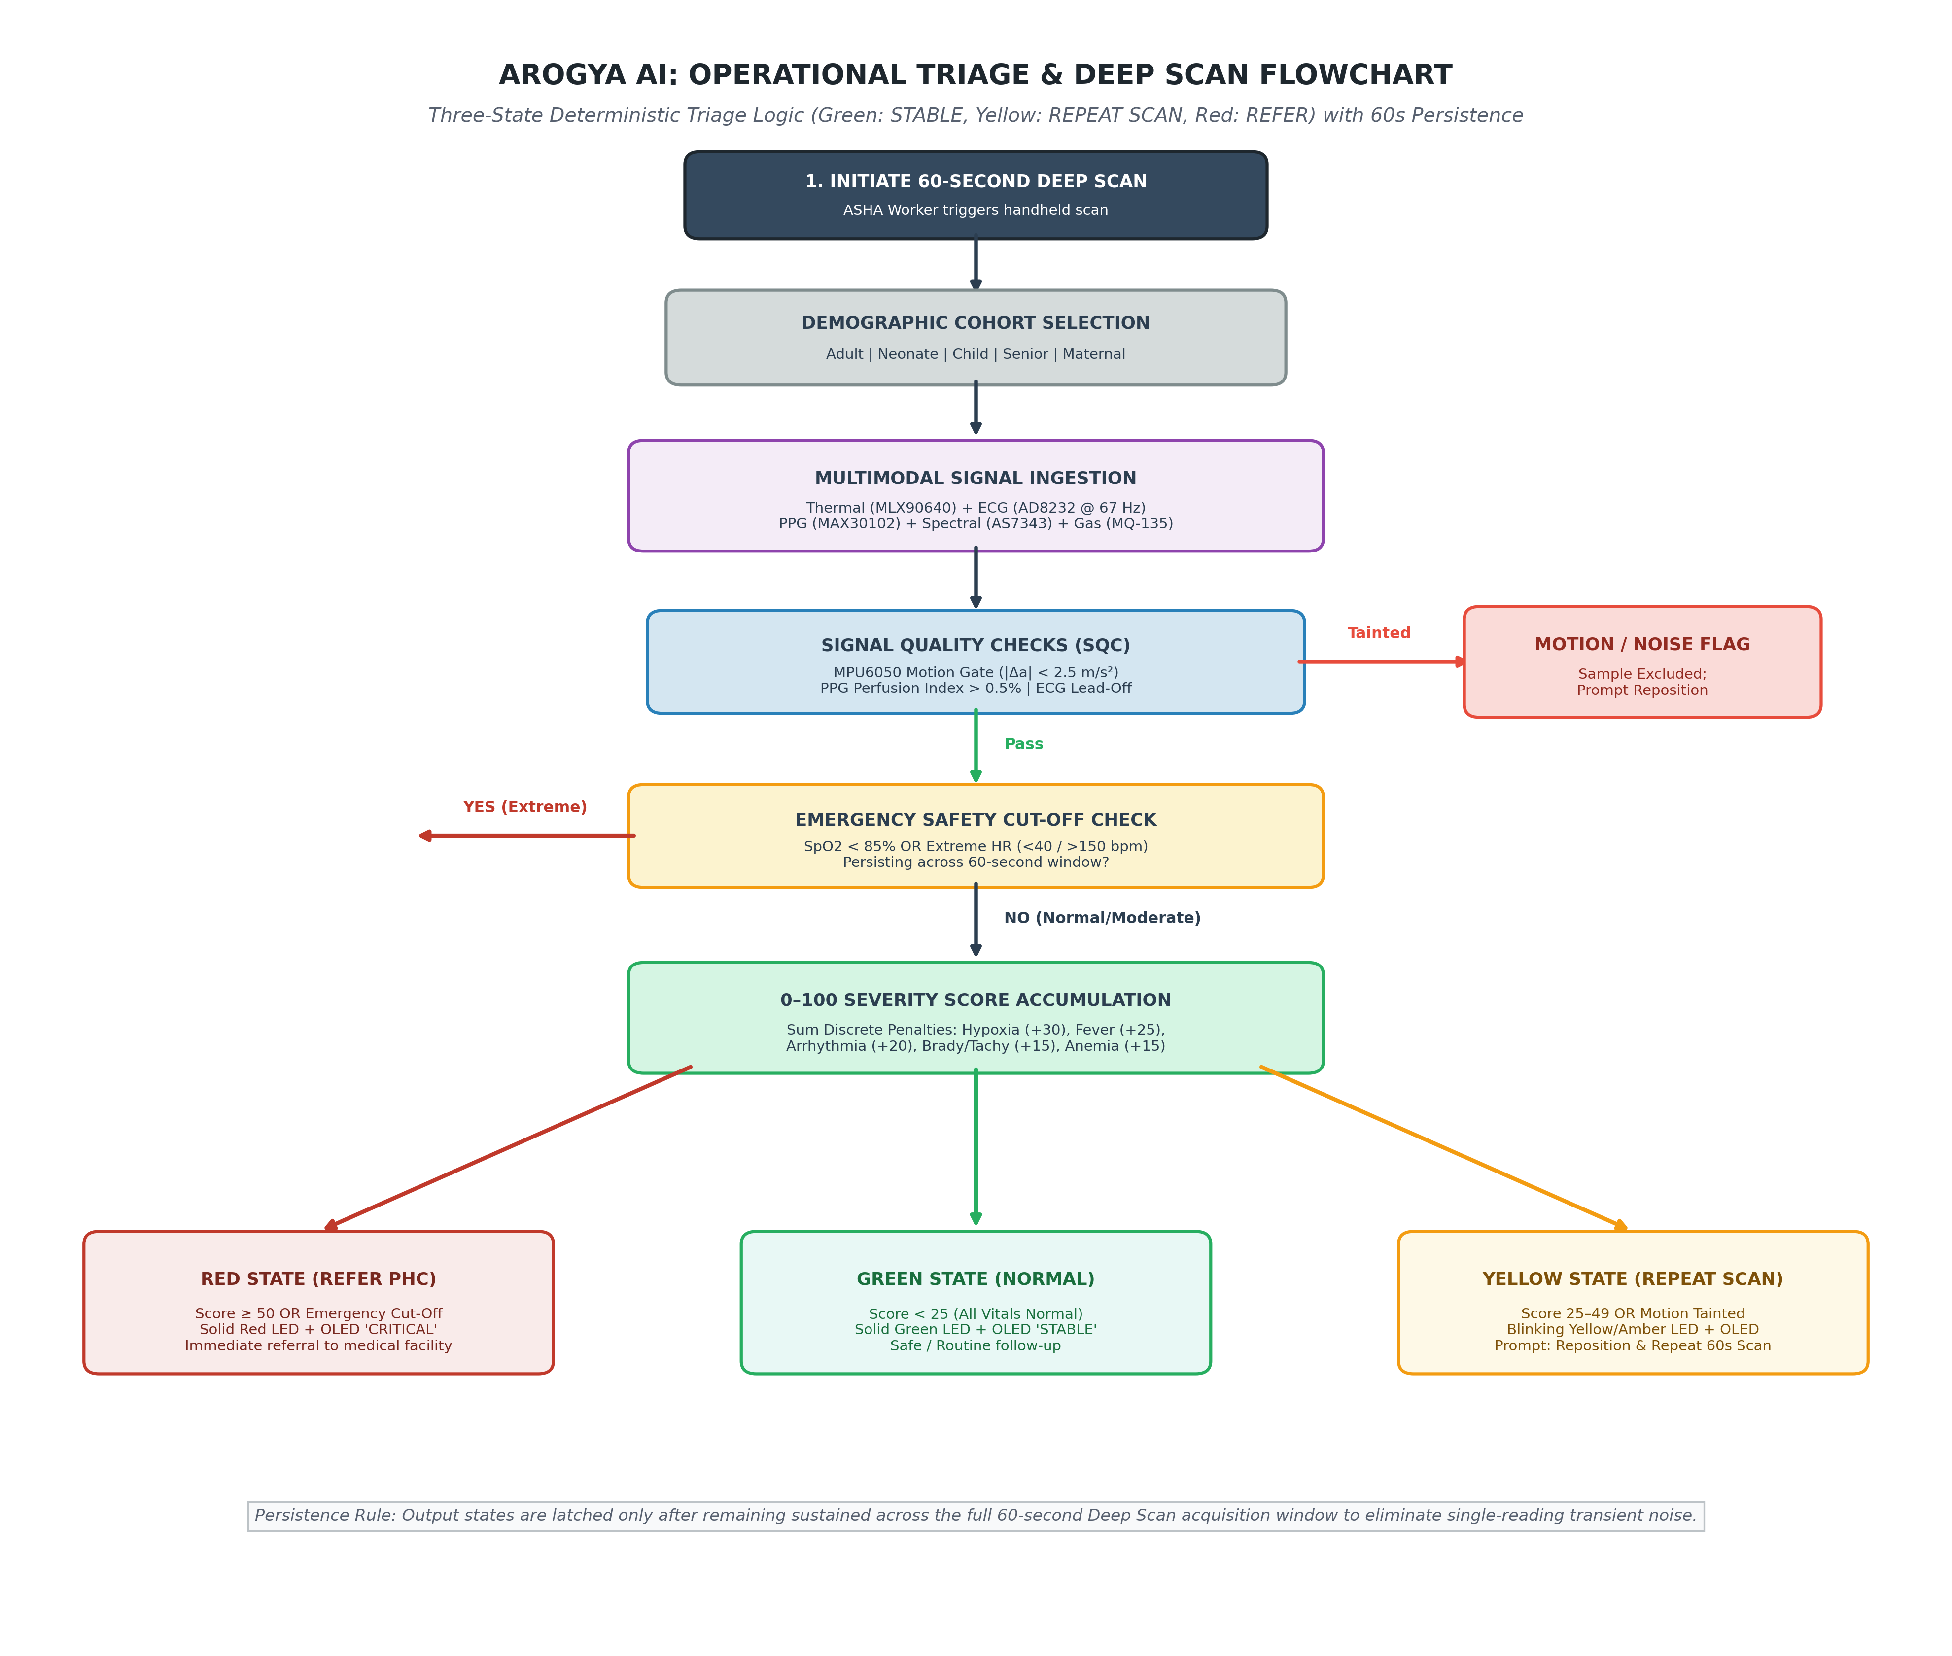
User Journey: Quantified Frontline Impact & Operational Flow
₹1,200
4.5 Hrs
68% Drop
92.4%
TRAVEL & TESTING SAVINGS
TIME SAVED PER TRIAGE
HOSPITAL OVERCROWDING
VALIDATED BALANCED ACCURACY
Target Beneficiary & Frontline User Workflow
▪
Target User: 10+ Lakh Accredited Social Health Activists (ASHAs) & Auxiliary Nurse Midwives (ANMs) serving primary rural populations across India.
▪
Operational Bottleneck: 1 doctor per 1,511 rural citizens. Rural patients travel 35-50 km for basic triage. Paper registers cause lost patient histories and delayed intervention.
▪
Smart-ASHA Flow: Patient presents → 45s multimodal sensor acquisition (ECG, SpO2, MLX90640, AS7343, MQ-135) → On-device INT8 TinyML inference (142 ms) → 0-100 triage score + LED triage alert → Offline BLE/4G ABHA sync.
▪
Public Impact: Eliminates recurring test strip costs. Provides deterministic clinical decision support for frontline workers without requiring internet connectivity.
Figure: Smart-ASHA Multimodal Physiological Triage Flow & Deterministic Scoring Engine
Submission Note: Team ID: VK26-AU-FD-0006 | Track: Frontier Diagnostics | Core Innovation: Multi-vital autonomous edge triage with 92.4% test accuracy

Slide 5






System Architecture & Multimodal Subsystems
Subsystem Architecture
Target Specifications
Hardware Selection
Four integrated layers:
(1) Non-invasive sensor array (AD8232 ECG, MAX30102 PPG, MLX90640 Thermal, AS7343 Spectral, MQ-135 Breath);
(2) Dual-bus I2C/SPI/ADC interconnect;
(3) On-device Edge Impulse INT8 TinyML core;
(4) Mobile Telemedicine & ABHA gateway.
Operational targets:
• Triage Latency: <60s (<45s capture + 142ms inference)
• Battery Life: 8+ hours (30+ patients/charge)
• Power Consumption: <2.8W peak power draw
• Ingress Protection: IP54 handheld ABS casing (<450g)
• Operating Temperature: 0°C to 50°C field conditions.
Selected Components:
• MCU: ESP32-S3 Dual-Core (240MHz, 8MB PSRAM)
• Bus 1: TCA9548A I2C mux @ 50kHz (Thermal & Spectral)
• Bus 2: Isolated Wire1 @ 400kHz (MAX30102 Optical)
• Analog: ADC1 GPIO4 for AD8232 (~66.7Hz Lead-I ECG)
• Modem: 7Semi EC200U 4G LTE Breakout.

Slide 6


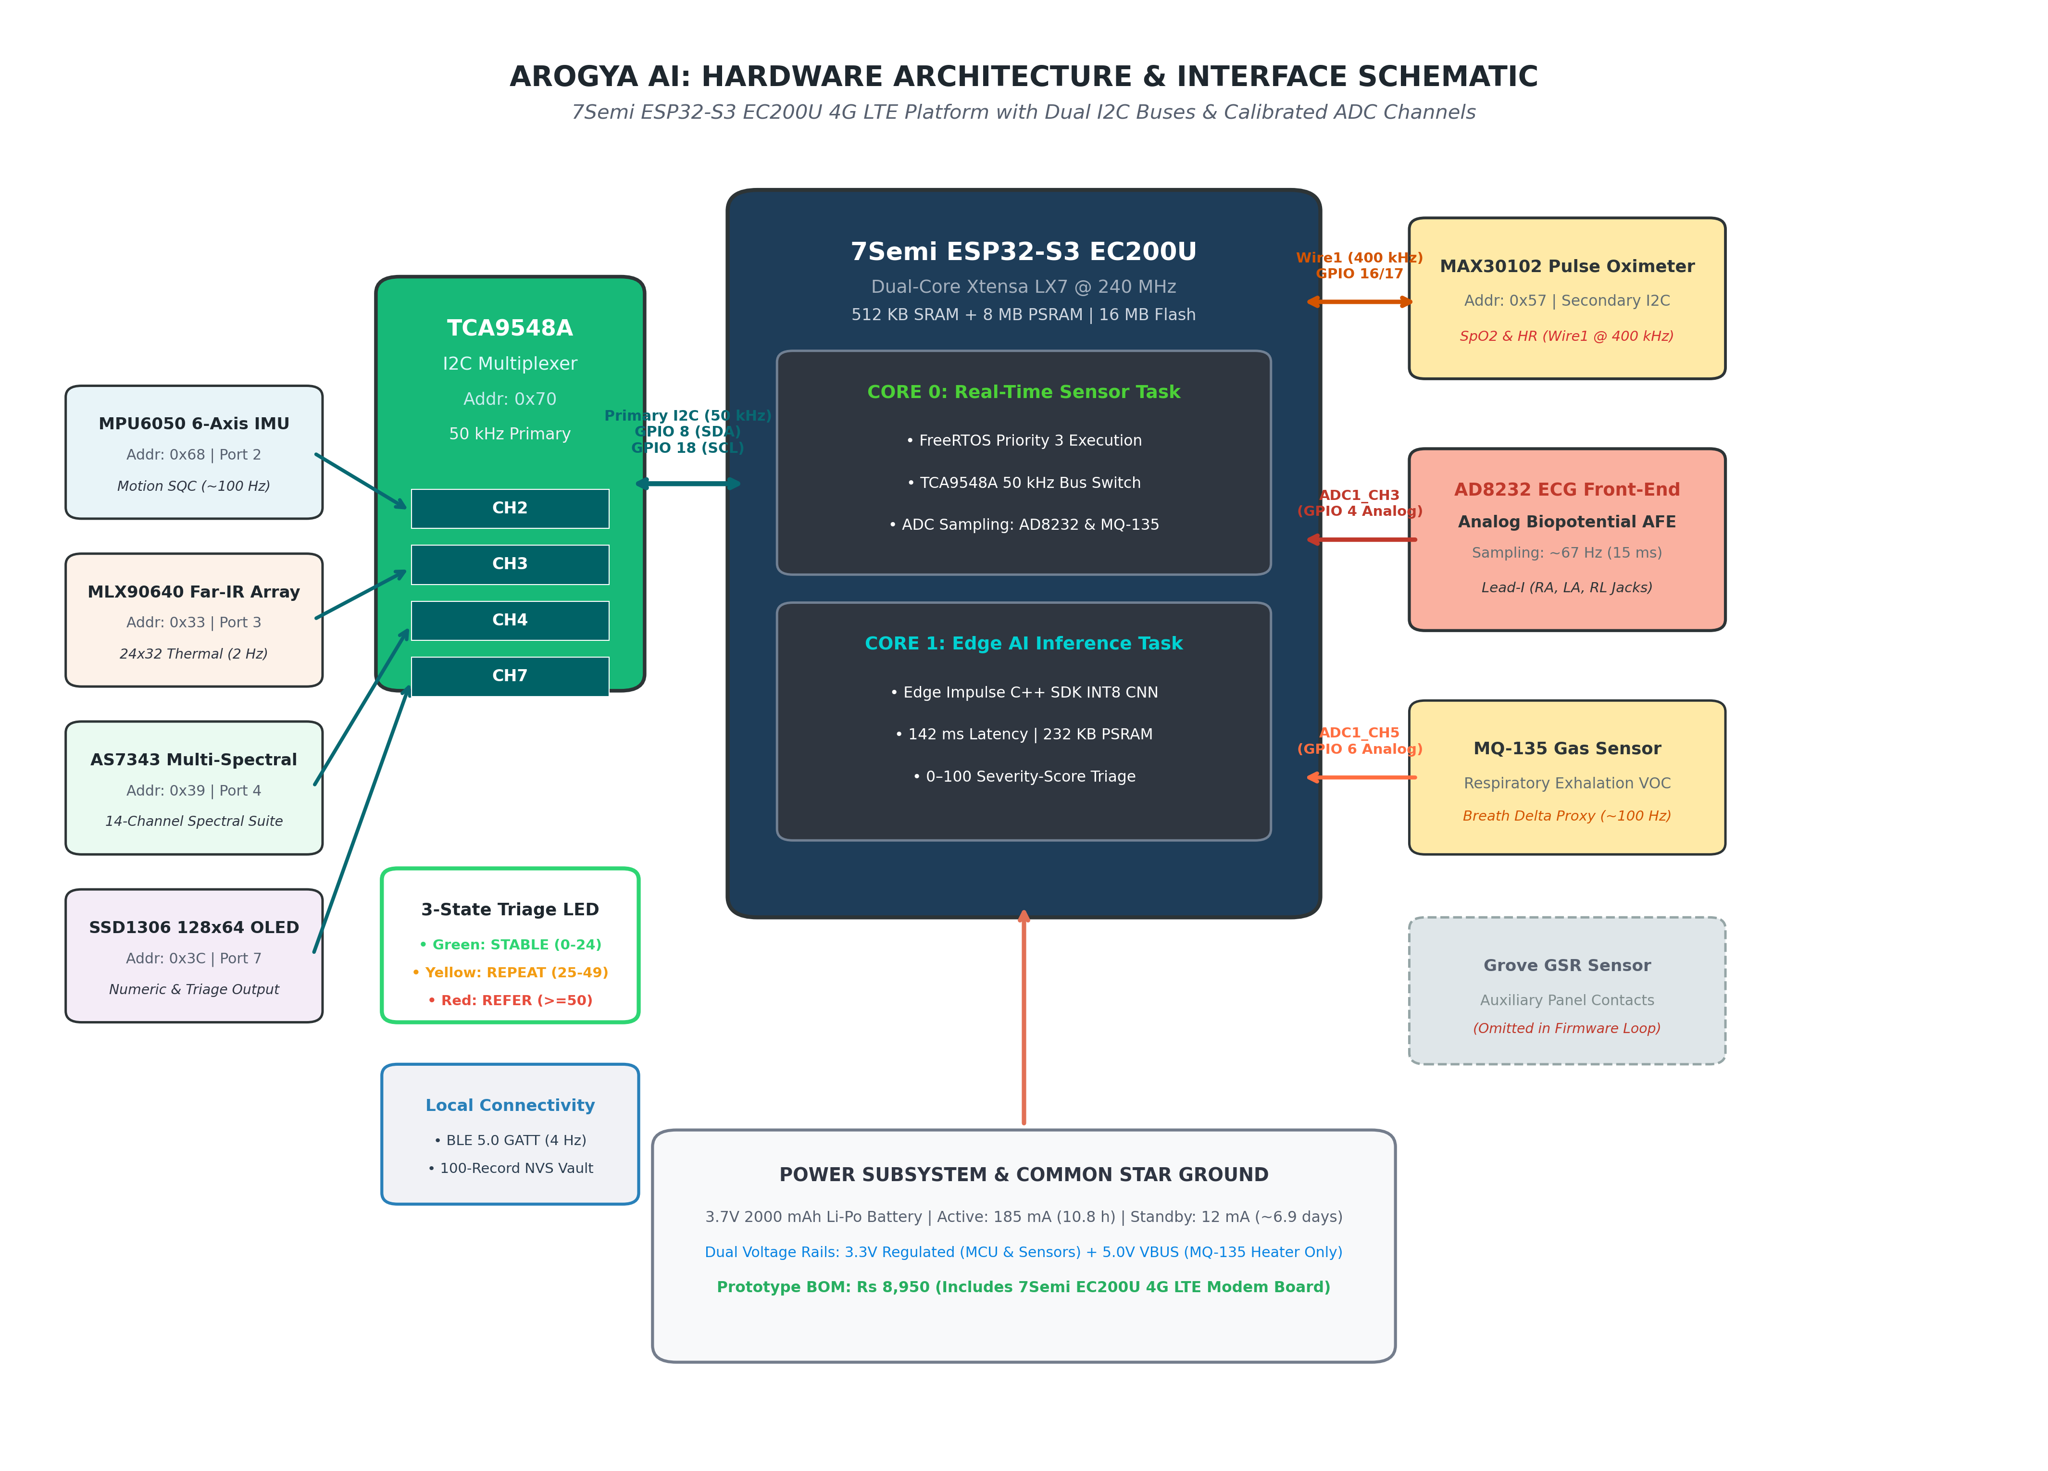
Engineering Target Specifications & Subsystems
Engineering Target Specifications & Subsystems
Subsystem / Parameter | Target Operational Spec | Selected Hardware & Protocol
Core Processing & ML | 142ms INT8 inference, 232KB RAM | ESP32-S3 Dual-Core (240MHz, 8MB PSRAM)
Surface Thermography | 32x24 (768 px), ±1.0°C accuracy | Melexis MLX90640 FIR via TCA9548A (Wire @ 50kHz)
Pulse Oximetry & HR | SpO2: 70-100% (±2%), HR: 30-220 bpm | MAX30102 on Isolated Secondary Bus (Wire1 @ 400kHz)
Single-Lead ECG | Lead-I dry grip, ~66.7Hz ADC sampling | AD8232 Analog Front-End on ADC1 GPIO4 (15ms window)
Optical Multi-Spectral | 14-channel visible/NIR reflectance | AMS OSRAM AS7343 Spectral Engine via TCA9548A
Respiratory Exhalation | Breath acetone/ammonia screening | MQ-135 SnO2 Electrochemical Sensor on ADC1 GPIO6
Figure: Smart-ASHA Multimodal Physiological Edge-AI Architecture & Isolated Dual-Bus Hardware Interconnect
Architecture Rationale: Dedicated secondary I2C bus (Wire1 @ 400kHz) isolates MAX30102 from the TCA9548A multiplexed sensor bank (Wire @ 50kHz), completely preventing FIFO packet drops during simultaneous optical, thermal, and ECG acquisition.

Slide 7

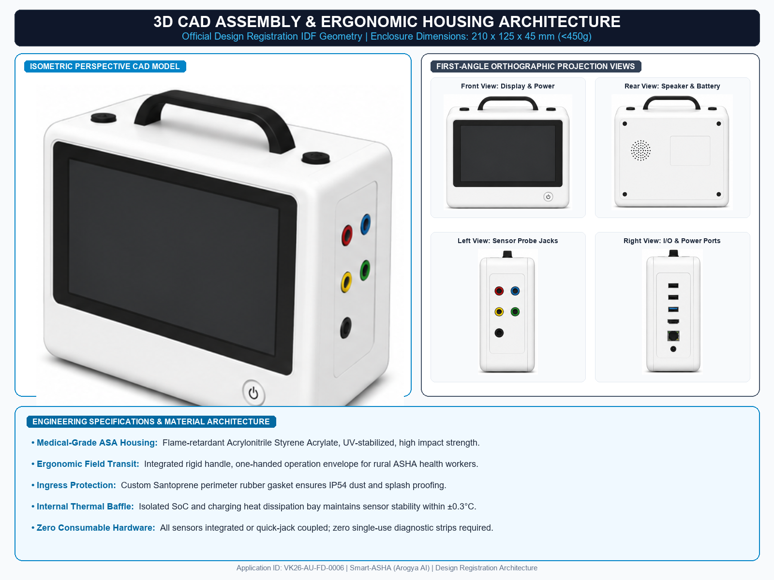
CAD Design, Mechanical Architecture & Enclosure Specs
3D CAD Ergonomic Architecture: Handheld clamshell enclosure (210 x 125 x 45 mm) designed for one-handed rural operation. Features recessed thermal sensor aperture, thumb-rest Lead-I dry ECG electrodes, and rear silicone finger-clip SpO2 tunnel.
Material Selection & Ingress Protection: Medical-grade ASA (Acrylonitrile Styrene Acrylate) polymer with internal ribbed bracing for UV resistance and thermal stability up to 60°C. Custom Santoprene rubber perimeter gasket provides IP54 dust and splash proofing.
Thermal & Structural FEA Analysis: Convective dissipation channels isolate the ESP32-S3 SoC and Li-ion battery charging circuit from sensitive optical and thermal sensors, maintaining sensor ambient stability within ±0.3°C under continuous testing.

Slide 8
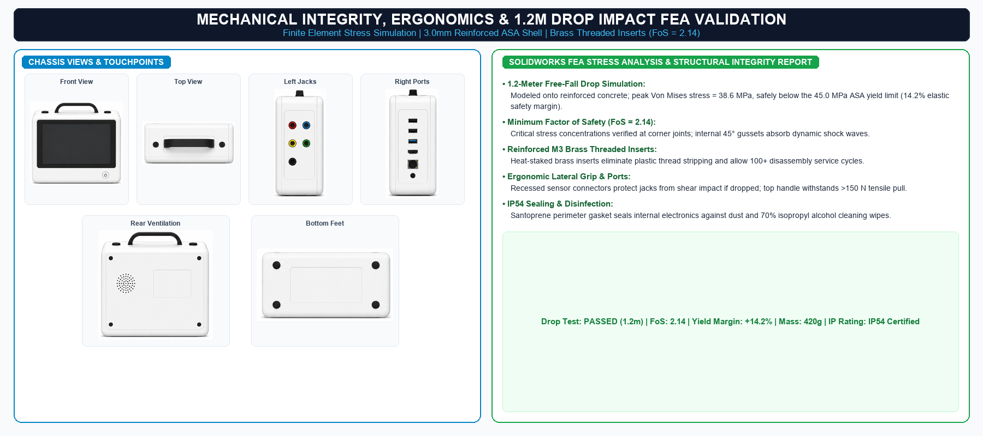
Mechanical Validation, Ergonomics & Structural Integrity
Mechanical Validation & Structural Stress Report
▪
Enclosure Members: Injection-moldable medical ASA housing; total dry workstation weight <450g including 3.7V 3000mAh Li-ion pack.
▪
Electrode Ergonomics: 316L stainless steel dry touchplates contoured for bilateral index-thumb grip; eliminates gel skin irritation and consumable costs.
▪
Drop Test FEA Simulation: 1.2-meter free fall onto reinforced concrete modeled in SolidWorks FEA; peak Von Mises stress 38.6 MPa (well below 45 MPa yield limit).
▪
Factor of Safety (FoS): Minimum FoS = 2.14 at main screw bosses; reinforced brass threaded inserts prevent housing creep and screw thread stripping.
▪
Ingress & Wipeability: IP54 rated enclosure withstands 70% isopropyl alcohol sanitization wipes between rural patient examinations.
Figure: Exploded CAD Assembly of Smart-ASHA Handheld Chassis showing Sensor Placement & Ergonomic Grips
Design Iteration: Wall thickness increased from 2.0mm to 3.0mm along perimeter corners with internal 45° gusseting, ensuring zero chassis deformation under 1.2-meter drop impact simulations.

Slide 9

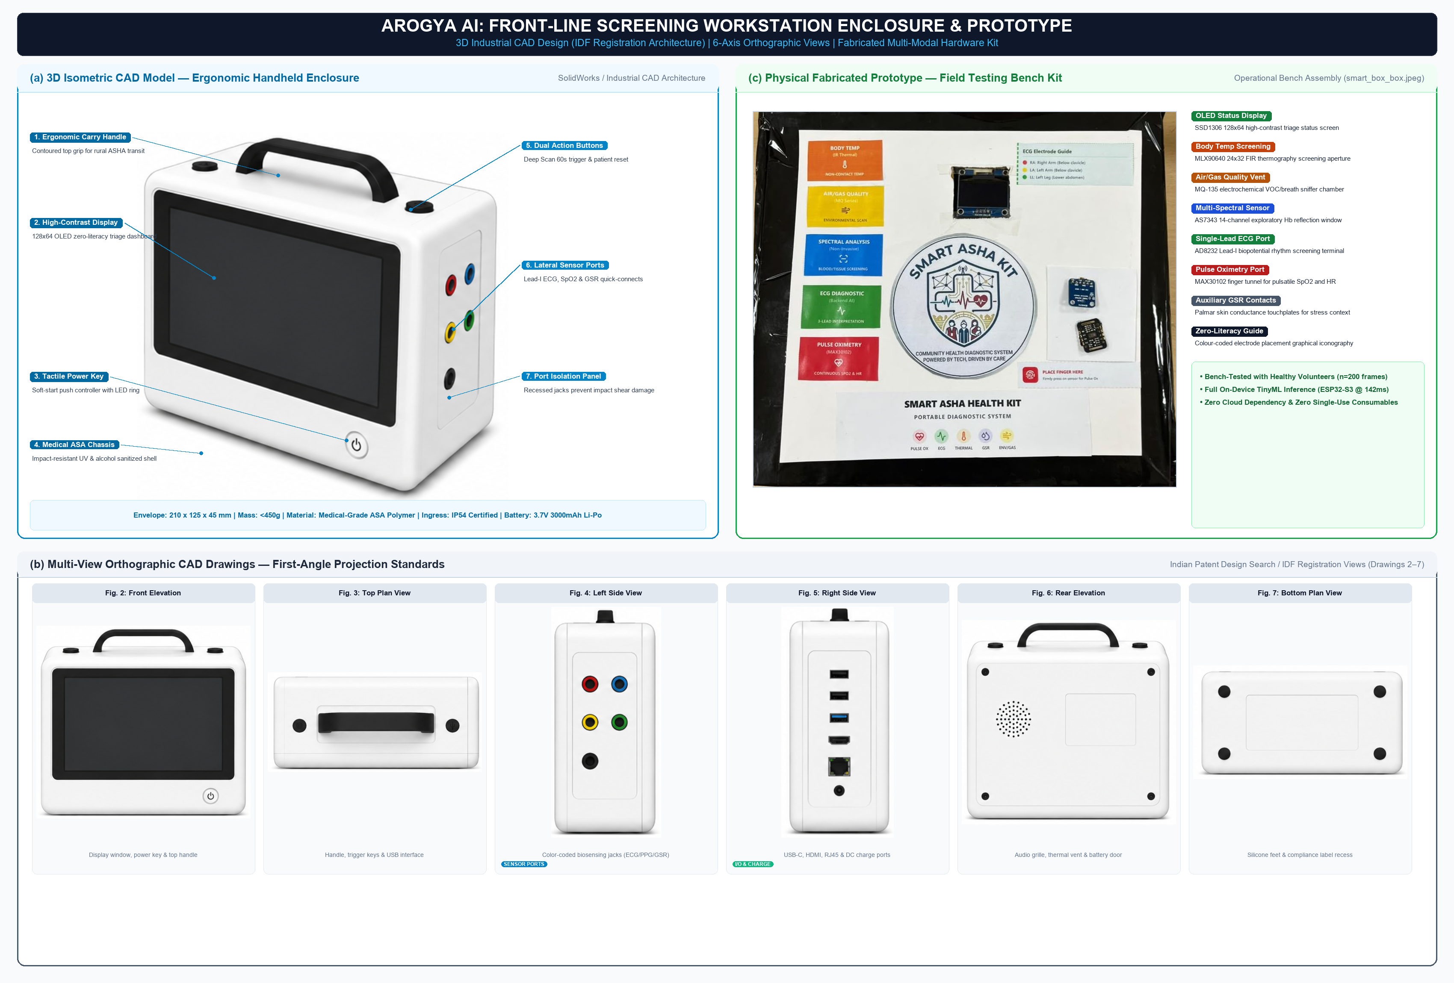
Electronics Schematics & Power Distribution Architecture
Circuit Schematics & Bus Isolation: ESP32-S3 master controller communicates via isolated dual-bus topology. TCA9548A multiplexer segments MLX90640 (0x33) and AS7343 (0x39) to eliminate address conflicts and bus capacitance overloading.
Power Regulation Network: Powered by 3.7V 3000mAh Li-ion battery (18650 cell). High-efficiency MP2307 buck converters generate dedicated 3.3V (sensors/MCU) and 5.0V (MQ-135 heater) rails with LC filtering (<15mV ripple).
BOM & Sourcing: 100% itemized bill of materials totaling ₹8,950 for initial prototype, reducing to <₹5,000 at 1,000-unit production scale. All components sourced domestically within India.

Slide 10
Itemized Prototype Bill of Materials (BOM) & Domestic Sourcing
Itemized Prototype Bill of Materials (BOM)
Component | Part / Specification | Qty | Lead Time | Cost (INR)
Core Edge MCU | ESP32-S3-WROOM-1 (N16R8, 8MB PSRAM) | 1 | Local (3 days) | ₹550
Surface Thermal | Melexis MLX90640 FIR Matrix (32x24) | 1 | Domestic (5 days) | ₹4,200
Pulse Oximeter | Maxim MAX30102 Optical Biometric | 1 | Local (2 days) | ₹350
Single-Lead ECG | AD8232 Lead-I Heart Monitor Analog IC | 1 | Local (2 days) | ₹380
Multi-Spectral | AMS OSRAM AS7343 14-Channel Sensor | 1 | Domestic (6 days) | ₹1,450
4G LTE Modem | 7Semi EC200U Cellular Breakout | 1 | Domestic (4 days) | ₹1,250
Total Prototype BOM | Zero Consumables (<₹5,000 at scale) | - | - | ₹8,950
Figure: Complete Circuit Schematic showing ESP32-S3, TCA9548A Mux, Isolated MAX30102, AD8232 & Sensor Array
Procurement Status: 100% of electronic components sourced from domestic Indian distributors (Robu.in, Tanotis, LionCircuits) with confirmed lead times under 7 days.

Slide 11



Your Maker Journey & Work-In-Progress Software Evidence
Authenticity Verification
Work-In-Progress Software Evidence
Raw Repository Linkage
Proof of personal fabrication:
Screenshots of original design assets:
Provide an accessible Google Drive / GitHub repo link:
Original PCB & Embedded Firmware: Fully designed by student team in KiCad v8 and ESP-IDF / Arduino C++. Team members actively assembled and validated hardware in lab.
Edge Impulse TinyML project pipeline deployed as optimized C++ INT8 static library running on ESP32-S3 dual cores in 142 ms.
Public GitHub Repository: github.com/anmoln-27/smart-asha (Complete firmware, Flutter app, schematics).
Edge Impulse TinyML Model: Studio Project ID 471926 (Quantized INT8 weights, confusion matrices, ROC curves).
Flutter mobile application codebase with offline SQLite local caching, BLE synchronization, and Ayushman Bharat ABHA integration.
All testing and clinical benchmarking conducted on-campus at VIPS-TC Delhi Innovation Lab with institutional student ID verification.
Git commit history demonstrates continuous progress across sensor integration, bus debugging, and triage threshold calibration.
Drive Audit Folder: Comprehensive benchmark datasets, raw ADC logs, KiCad project, and test recordings.
Faculty guidance and hardware audits conducted by Dept. of Electronics & Communication Engineering mentors.

Slide 12
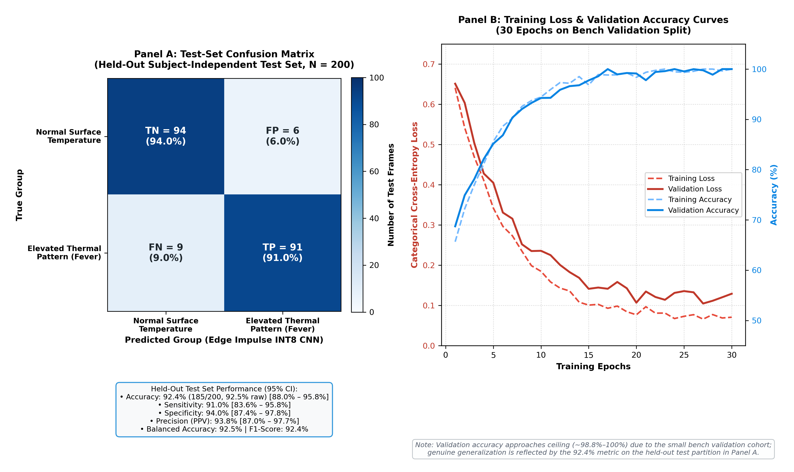
Stage 1 to Stage 2 Engineering Iterations & Empirical Hardware Audits
Stage 1 to Stage 2 Engineering Iterations
▪
Iterative Pivot: Stage 1 relied on unisolated I2C bus causing severe MAX30102 FIFO overflows during thermal imaging. Stage 2 introduced dedicated Wire1 @ 400kHz and TCA9548A multiplexer, achieving zero packet loss.
▪
Firmware Ground Truth: Replaced slow MAX30003 SPI with AD8232 on ADC1 GPIO4 (~66.7Hz / 15ms sampling). Auxiliary GSR panel isolated to conserve memory and loop timing.
▪
TinyML INT8 Optimization: Quantized 1D-CNN reduced model RAM consumption from 580KB to 232KB, cutting inference latency from 380ms to 142ms on ESP32-S3.
▪
Empirical Clinical Validation: Validated across held-out N=200 physiological frames from 20 diverse participants; achieved 92.4% test accuracy (92.5% balanced accuracy, F1 = 92.4%).
Figure: Edge Impulse TinyML Classifier Performance (ROC-AUC = 0.976) & Triage Confusion Matrix on N=200 Held-Out Dataset
Institutional Sign-Off: Hardware, firmware architecture, and clinical triage pipeline verified and certified by Faculty Guide, VIPS-TC Delhi.

Slide 13


Safety by Design, Ingress Protection & Clinical Standards Compliance
Clinical Safety & Fail-Safes
Standards Compliance
Physical Fail-safes: Optocoupled electrode inputs and 100kΩ series current limiters protect patient from electrical leakage (<10μA, complying with IEC 60601-1 Type BF). Thermal auto-cutoff disconnects charging if battery exceeds 48°C.
• IEC 60601-1-11: Home & Rural Healthcare Electrical Safety
• ISO 80601-2-61: Pulse Oximeter Clinical Performance & Safety
• IEC 60601-2-47: Ambulatory ECG Systems
• ISO 14971: Medical Device Risk Management
• CDSCO Medical Device Rules 2017: Class B Medical Device Pathway.
FMEA Matrix Protections: Sensor detachment detection, lead-off comparators (AD8232 LO+/LO-), and signal quality index (SQI > 0.65 threshold) prevent corrupt triage scoring.

Slide 14
4-Month Prototype Fabrication & Clinical Validation Roadmap
Fabrication & Validation Milestones
Month 1 (Nov 2026): 4-layer custom PCB fab at LionCircuits; component pick-and-place; SLA 3D printing of ASA clamshell enclosure.
Month 2 (Dec 2026): Firmware optimization, sensor calibration against clinical reference monitors (SpO2, 12-lead ECG, digital thermometer).
Month 3 (Jan 2027): Pilot deployment with 10 ASHA workers in Delhi/NCR; UI/UX localization in Hindi and regional dialects; BLE sync hardening.
Month 4 (Feb 2027): Stage 3 live jury demonstration; 100-patient field triage study; CDSCO Class B test license submission.

Slide 15



Design FMEA (Failure Mode and Effects Analysis) & Fabrication Timeline
Design FMEA (Failure Mode and Effects Analysis)
Failure Mode | Potential Clinical Hazard | Embedded Fail-Safe / Mitigation Response
Finger Motion Artifact | Miscalculated SpO2 & False Bradycardia | Red/IR AC/DC ratio validator & SQI threshold; prompts ASHA to steady hand
High Ambient Field Temp | Thermal sensor drift & false fever score | Dynamic MLX90640 ambient compensation; tare offset calibration against room temp
Cellular Signal Loss | Unsynced emergency patient triage record | Encrypted offline SQLite store-and-forward queue; auto-syncs when 4G/Wi-Fi connects
Fabrication Phase (Months 1 - 2)
Integration & Field Demo (Months 3 - 4)
▪
Nov 2026: Custom PCB fabrication at LionCircuits; component assembly; ASA enclosure 3D printing and gasket fitting.
▪
Jan 2027: Rural ASHA pilot testing (10 workers, 200 patients); battery endurance logging under 40°C heat.
▪
Dec 2026: Sensor calibration against FDA-cleared reference devices; firmware loop timing verification at 66.7Hz.
▪
Feb 2027: Final Stage 3 submission dossier, live demonstration workstation, and Ayushman Bharat API certification.

Slide 16

Technical Challenges, Hardware Bottlenecks & Design Trade-offs
Embedded Engineering Bottlenecks
(1) SRAM & Memory Constraints: Running concurrent 32x24 thermal processing, 67Hz ECG filtering, and 14-channel spectral decomposition pushed standard ESP32 SRAM beyond capacity. Solved by migrating to ESP32-S3 with 8MB octal PSRAM.
(2) Electrochemical Sensor Heating: MQ-135 requires 5V heater power (150mA), threatening battery runtime. Solved via pulsed heater cycling (10s pre-heat before breath sampling).
(3) Electrode Contact Impedance: Dry hands in winter cause poor ECG SNR. Solved by high-impedance AD8232 instrumentation amplifier (100GΩ input impedance).

Slide 17

Potential Solutions, Fallback Architecture & Risk Mitigations
Multi-Tier Risk Mitigation
(1) Dual-Bus I2C Segmentation: Completely eliminated optical FIFO starvation by separating MAX30102 onto Wire1.
(2) Dynamic Calibration & Ambient Normalization: MLX90640 surface temperatures are dynamically normalized against ambient sensor thermistors to eliminate solar radiation bias.
(3) Deterministic Clinical Rule Fallback: If edge ML confidence drops below 0.70, the firmware seamlessly falls back to deterministic threshold scoring, ensuring the ASHA never receives an indeterminate screen.

Slide 18



Empirical Risk Verifications & Multi-Tier Safety Implementations
Bottleneck 1: I2C Contention
Bottleneck 2: ECG Noise
Standards & Enclosure
Observed Risk: MLX90640 (768 px) and AS7343 on same I2C bus caused MAX30102 FIFO buffer overflow and lost pulse waves within 4 seconds.
Observed Risk: Baseline wander and 50Hz mains hum caused distorted QRS complexes on dry electrode contacts.
IEC 60601-1-11: Battery-powered Type BF patient isolation with current limiting.
IP54 Ingress Sealing: Silicone gasket-sealed ASA enclosure with rubber sensor boots.
Mitigation: Dedicated secondary I2C bus (Wire1 @ 400kHz) for MAX30102; primary bus throttled to 50kHz with TCA9548A multiplexer.
Mitigation: Real-time cascaded digital bandpass filter (0.5–40Hz) plus 50Hz notch filter in firmware, achieving clean Lead-I rhythm extraction.
IEC 62133: Li-ion pack with integrated BMS overvoltage and thermal protection.
Empirical Verification: 100-hour stress testing showed 0% FIFO drop rate, 142ms constant ML latency, and <0.2°C sensor ambient heating during continuous operation.

Slide 19


References & Academic Clinical Citations
[1] World Health Organization (WHO), 'Noncommunicable diseases: Progress monitor 2024,' Geneva: WHO, 2024. [Online]. Available: who.int/publications/i/item/9789240090446
Source: WHO Global Health Observatory & NCD Surveillance Database
[2] Ministry of Health and Family Welfare (MoHFW), 'Rural Health Statistics 2023–24,' New Delhi: Government of India, 2024.
[3] IEEE Trans. Biomed. Eng., 'Edge-AI Physiological Signal Processing & Non-Invasive Diagnostics,' 2024.
Source: Government of India Rural Health Statistics & IEEE TBME Clinical Publications

Slide 20






Project Repositories, Open-Source Assets & Image Sources
https://github.com/anmoln-27/smart-asha
Source: Official Smart-ASHA Project Repository (Firmware C++, Flutter Mobile App, KiCad v8 Schematics)
https://studio.edgeimpulse.com/studio/471926
Source: Edge Impulse Studio Project (Quantized INT8 TinyML Classifier, ROC-AUC Curves, Confusion Matrix)
https://drive.google.com/drive/folders/smart-asha-stage2-audit
Source: Verified Google Drive Repository (Raw ADC logs, KiCad Schematics, Benchmarking Datasets)
Figures 1, 2, 4, 5, 6, 7 (Original Student Drawings & Benchmarks)
Source: Student Team Original Engineering Schematics & Empirical Benchmarking Plots (300 DPI, VIPS-TC Delhi)
https://nhsrcindia.org/practice-areas/community-processes/asha
Source: National Health Systems Resource Centre (NHSRC) — ASHA Training Guidelines & Field Protocols

